Slide 1



SMART INDIA HACKATHON 2024
Problem Statement ID – 1626
Problem Statement Title - Health Data Information & Management System Mobile Application (HDIMS)
Theme - HealthTech
PS Category- Software
Team ID- 081
Team Name: TechBees
Problem statement provided by SIH :
To develop a Mobile Application which will help the hospitals/facilities to enter data directly, which can be viewed by the Super Admin dynamically for efficient implementation of Health and Family Welfare Schemes, other Health programs and provide key inputs for policy formulation.

Slide 2

HDIMS Structure
HDIMS APPLICATION
Administrative Side
Facility Side
Sub-District Admin :
View aggregated data from facilities within district
Data Entry
District Admin :
View aggregated data from facilities within district
# This Flowchart explains complete data flow from healthcare facilities to different levels of government.
State Admin:
View aggregated data from districts within the state
Super Admin(Central):
Aggregated data from all states.

Slide 3
CHALLENGES IN PRE-EXISTING PLATFORMS
Fragmented Health Data
Need for Centralized Oversight
Inconsistent Reporting
Low Data Accuracy
Slow Policy Response
Health information data is usually dispersed over a several systems, which lead to delays in decision-making.
Disparity in data reporting at various levels (local, district, state) lead to challenges when assessing accurate health program outcomes.
Manual data entry errors and outdated systems often lead to inaccurate health data, affecting the quality and time of healthcare delivery.
Data collection delays and result analysis is slow policy adjustments and interference, affect the advantages of health programs.
A centralized system is important for health monitoring programs, to ensure regular implementation across regions.

Slide 4
HEALTH DATA INFORMATION & MANAGEMENT SYSYEM
Approach :
Our solution aims to provide a centralized mobile application designed for seamless healthcare data collection, management and analysis across all facilities and administrative institutions in India. It features –
Real-time dynamic dashboards.
Image processing for entering manual records.
Automated alert system for significant data changes.
Query generation feature across administrative levels to facilitate healthcare related concerns.
Blockchain for data security.

Slide 5
FEATURES:
Admin Side: ( District, State, Central)
View & manage aggregated facility data across district.
2. Downloadable data in Excel format.
3. Query generation & communication: Enables raising healthcare related concerns within district, state & central
4. Real time & Dynamic dashboards
5. ML driven alert mechanisms.
6. Blockchain Integration for Security.
Facility
Sub-District
Unified Platform
District
Facility Side:
1. Enter & Update facility data & records.
2. Image Processing to facilitate entry of paper written & manually maintained records.
3. Blockchain Integration for Security.
State
Central

Slide 6
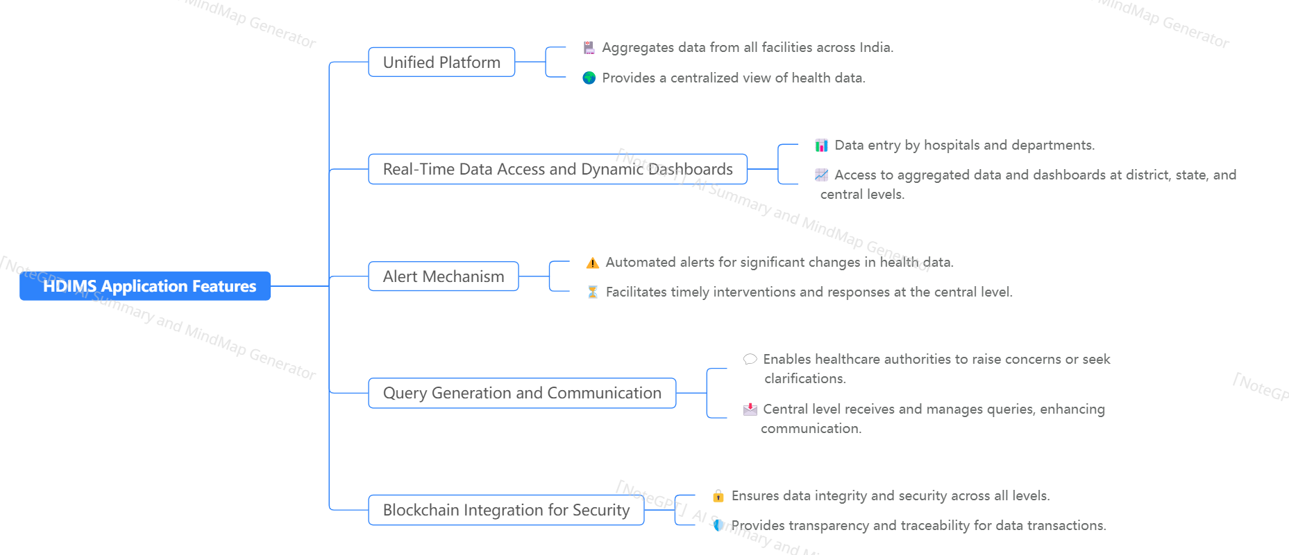
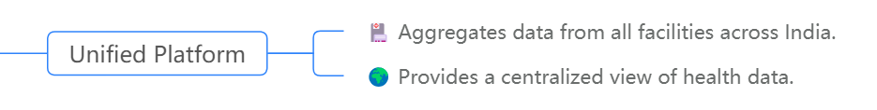
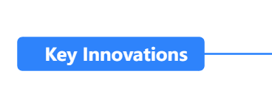
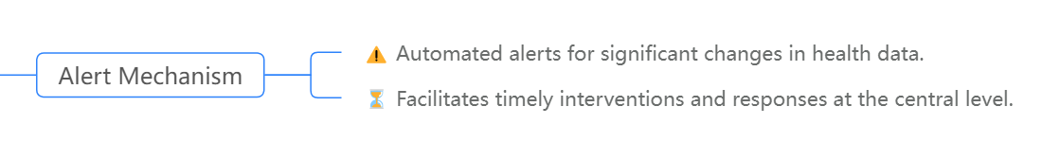
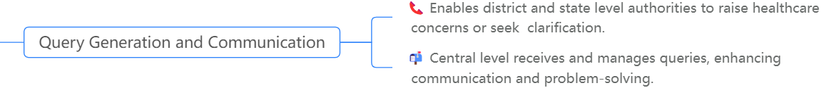







KEY INNOVATIONS

Slide 7
Key Innovations in Detail
Unified Platform: HDIMS provides a centralized platform that aggregates health data across all facilities in India into a single, cohesive system in contrast to existing fragmented healthcare management systems across different regions.
Real-Time Data Access and Dynamic Dashboards: HDIMS offers real-time, dynamic dashboards enabling quick
decision-making and responsiveness instant access to up-to-date data for policymakers and administrators at district, state, and central levels.
Provides interactive dashboards for visualizing health indicators, trends, and statistics.
Alert Mechanism:
Automated alerts to central authorities for significant changes in health data (e.g., disease outbreaks).
Facilitates timely interventions and response by healthcare authorities.
Query Generation and Communication:
Enables healthcare authorities at different levels to raise concerns or seek clarifications directly from central authorities.
Enhances communication and problem-solving capabilities across healthcare hierarchy.
Blockchain Integration for Security:
Ensures data integrity and security through blockchain, preventing unauthorized access and tampering.
Provides transparency and traceability for all data transactions.

Slide 8
HDIMS SYSTEM OVERVIEW

Slide 9











TECH STACK
HDIMS
Rest API
Backend
Nodejs
APP
Data base
PostgreSQL
Frontend and Dashboard
ReactJS
Graphs
ML model
Python
Block chain
Hyperledger

Slide 10
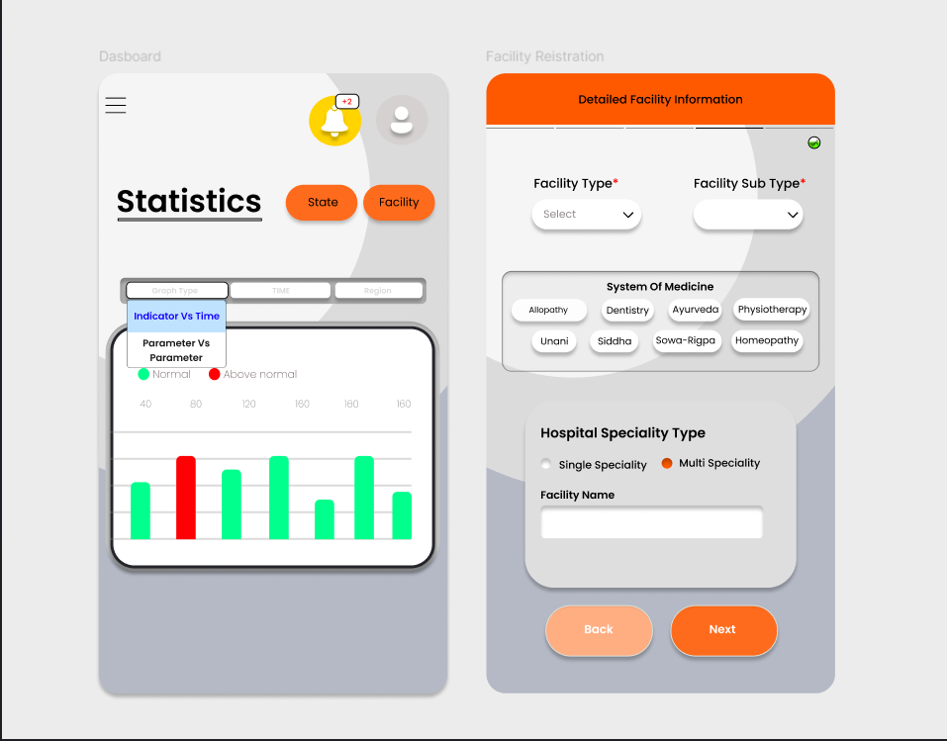
APP INTERFACE

Slide 11
Feasibility And Viability
Scalability: Simple to scale with SQL database.
Adaptability: can easily adapt to new data attributes that required.
CREATIVITY
Complex Querying: PostgreSQL has a lot of features to handle complex queries
Complete Data: Gathers data from public and private agencies to improve government input with ease
VIABILITY
FEASIBILITY
Security: Blockchain integration defends from cyber threats
Maintenance: Easier to maintain and support a familiar tech stack
Ease: Designed for ease of use by even the least educated data entry workers.
Policy Impact: Enhances policy-making, hence public health.

Slide 12

01
More Time For Nursing Care: HDIMS automates all of the paper work for healthcare workers to free them up from paperwork and give time in patient care.
Quicker Responses: HDIMS speeds up access to data, enabling faster action on health issues
Future Health Planning: Prepares leaders in advance by trend tracking of health over time.
06
02
IMPACT’S OF HDIMS
Alert Machanism:
A change in data within a specific aspect will trigger an alert to the admin, facilitating quicker decision-making within our HMIS application.
Better Coordination: Serves a common platform for efficient collaboration between hospitals and admin bodies.
05
03
Resource Efficiency: Resource is distributed where it will create the most difference.
04

Slide 13










FUTURE SCOPE
While currently focusing on maternity health, we plan to expand the system to encompass various other health domains
BROADER HEALTH COVERAGE
Develop interfaces that allow seamless data transfer from facilities using their own private software.
INTEGRATION WITH EXISTING SOFTWARE
Provide a dedicated platform for facilities that still use manual record-keeping to enter and manage patient data.
SUPPORT FOR MANUAL SYSTEMS
Create machine learning models to analyze health data, generate insights,
and recommend appropriate policies.
ADVANCED DATA ANALYTICS
Implement daily data collection and monitoring to keep track of health patterns and trends effectively.
DAILY HEALTH SURVEILLANCE

Slide 14
RESEARCH AND REFERENCES
1. Interaction with
Mrs. Jyoti Thorat Ma’am , Statistical Invigilator, Public Health Department, Government of Maharashtra
Dr. Kangule , Assistant Director, Health Services, Public Health Department, Government healthcare sector
Dr. Bhaleroa , Senior doctor and an integral part of management at Moraya Nursing Home
Senior Doctor at Bliss Multispeciality Hospital
2. HMIS official Government website –
https://hmis.mohfw.gov.in/#!/
3. About HMIS and the indicators –
https://nhsrcindia.org/sites/default/files/2021-04/Session%201%20Presentation%20for% 20Volume%201%20Service%20Providers%20Manual%20Introduction%20HMIS%20_0. pdf
4. Data Quality issues in HMIS -
https://www.nhsrcindia.org/sites/default/files/2021-04/HW%20Session%201%20Data%2 0Quality_0.pdf
5. Youtube playlist about how to use the HMIS app on data filling side - https://www.youtube.com/playlist?list=PLQK1Ew_QPrRa54p0ZyzOqyg2UHLLh7fzV
6. Surveys –
Bliss Multispeciality Hospital , Kondhwa
b. Moraya Nursing Home , Katraj

Slide 15


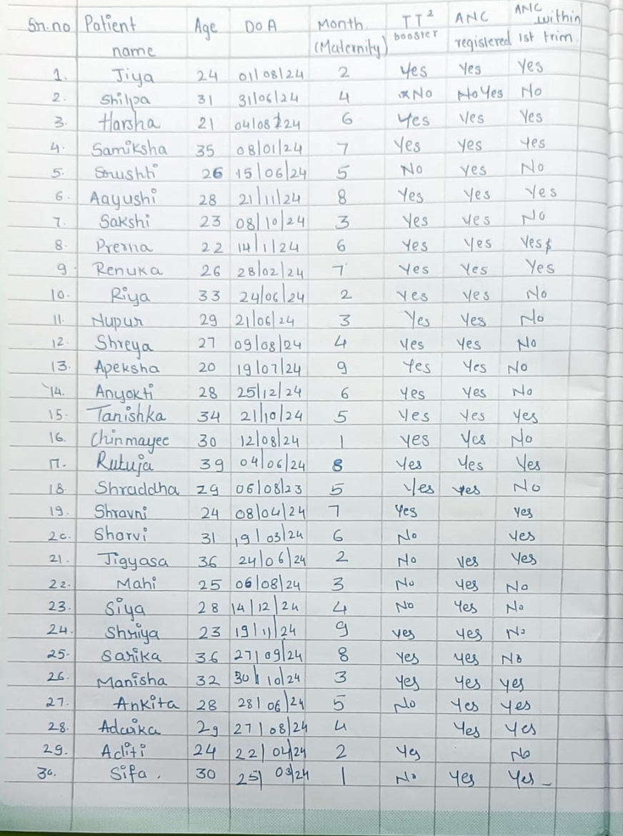
OCR DEMO
SR.NO,PATIENT NAME,AGE,DOA,MONTH (MATERNITY),TT2 BOOSTER,ANC REGISTERED,ANC WITHIN 1ST TRIM
,,,,,,,
1 .,,Jiya,24,01/08/24,2,Yes,Yes Yes
2 .,Shilpa,,31,31106124,4,No *,No Yes No
3 .,Harsha,,21,04108224,6,Yes,Yes Ves
4 .,Samiksha,,35,08/01/24,7,Yes,Yes yes
5 .,Shushh,,26 15,15/06/24,5,No,No yes
6.,Aayushi,,28,21/11/24,8,Yes,Yes Yes
7 .,Sakshi,,23,08/10/24,3,Yes,No ves
8 .,Prerna,,22,14/11/24,6,Yes,Ves Yes
9,Renuka,,26,28/02/24,Yes,Yes Yes
10,.,Riya,33,24/06/24,2,Yes,No yes
11,Nupur,,29,21/06/24,3,Yes,No Yes
12,Shreya .,,27,09/08/24,4,Yes,Yes No
13,. Apeksha,,19 20,107/24,9,Yes,Yes No
14 .,Anyakti,,28,25/12/24,6,Yes,No Yes
15.,Tanishka,,34,2110/24,5,Yes,Yes Yes
16 .,,Chinmayee,30,120824,,yes,No Yes
17 .,Rutuja,,39,04/06/248,,Yes,Yes Yes
18,,Shraddha,29,06/08/23,5,Yes,No yes
19,Shravni .,,24,08/04/24,1 7,Yes,Yes
2c,Sharvi .,,اور 31,324,6,No,Yes
21,.,Jigyasa,36,24/06/24,2,No,Yes Ves
22-,,Mahi,06/08 25,24,3,No,Yes No
23,. Siya,,14 28,24 12,4,No,Yes No
24,.,Shriya,23,1924,g,yes,No yes
25-,,Sarika,271 36,09/24,g,Yes,yes No
26,,Manisha,32,301024,3,Yes,Yes yes
27,.,Ankita,28 281,06 24,5,No,Yes yes
28,Adwika .,,27 29,08/24,ム,,Yes Yes
29,Aditi .,,24,220424,2,위원 Yes,23 هله
,30.Sifa,, 25,03/24,,No,Yes Yes

Slide 16
TechBees : Team Members
Team Leader Name : Srushti Ghogare
Branch : Btech Stream : CSE Year : 2nd Year
Team Member 1 Name : Aayushi Maindalkar
Branch : Btech Stream : CSE IT Year : 2nd Year
Team Member 2 Name : Samiksha Surwase
Branch : Btech Stream : CSE Year : 2nd Year
Team Member 3 Name : Tanish Kulkarni
Branch : Btech Stream : CSE Year : 2nd Year
Team Member 4 Name : Pranav Bhosale
Branch : Btech Stream : CSE Year : 2nd Year
Team Member 5 Name : Kartik Shinde
Branch : Btech Stream : CSE Year : 2nd Year
Team Mentor 1 Name : Mrs. Laxmi Bewoor
Category : Academic Expertise : AI & ML

